Slide 1



Searching for Inflow Towards Massive Starless Clump Candidates Identified in the Bolocam Galactic Plane Survey
Jenny Calahan
Steward Observatory
Advisor: Dr. Yancy Shirley
Steward Observatory
Arizona Space Grant Symposium 2018 Tucson, AZ

Slide 2
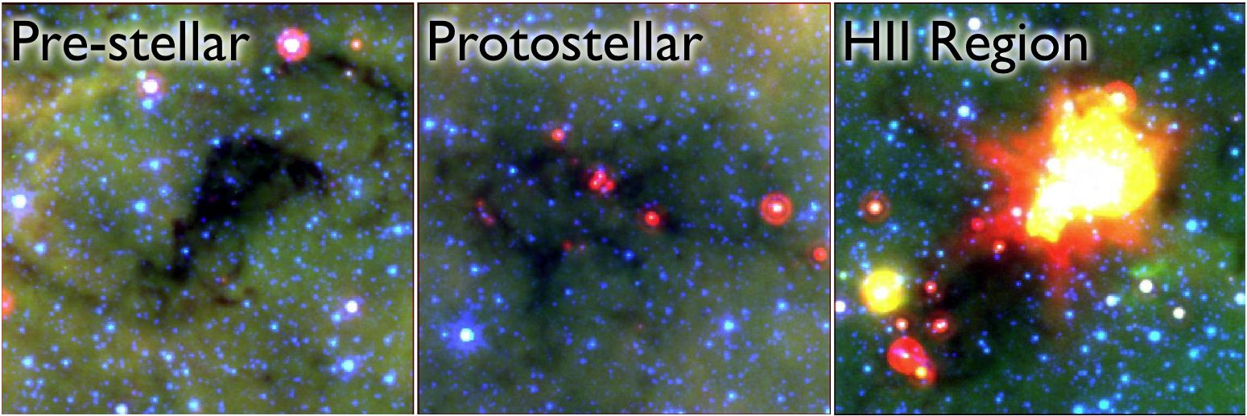
Searching for Inflow Towards Massive Starless Clump Candidates Identified in the Bolocam Galactic Plane Survey
Notes:
----- Meeting Notes (5/4/16 17:24) -----
typical: 230 solar mass
1 parsec
put arrows on pestellar

Slide 3
Searching for Inflow Towards Massive Starless Clump Candidates Identified in the Bolocam Galactic Plane Survey

Slide 4
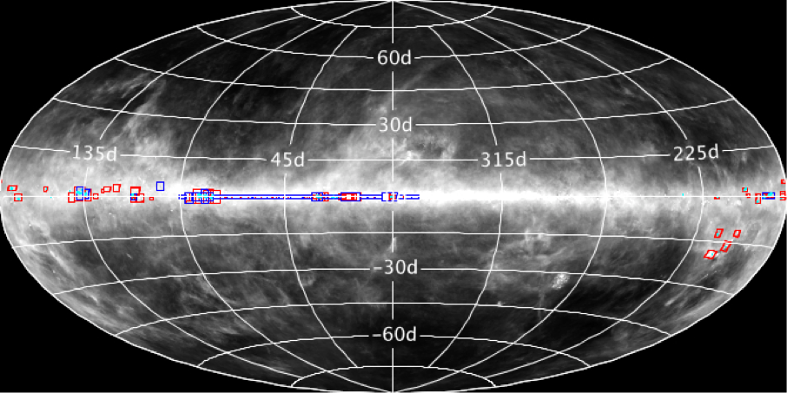
Searching for Inflow Towards Massive Starless Clump Candidates Identified in the Bolocam Galactic Plane Survey

Slide 5
What’s up with massive star formation?
Time scale of formation
Occurrence in galaxy
Kinematics of the collapse
Low mass → High mass star formation

Slide 6
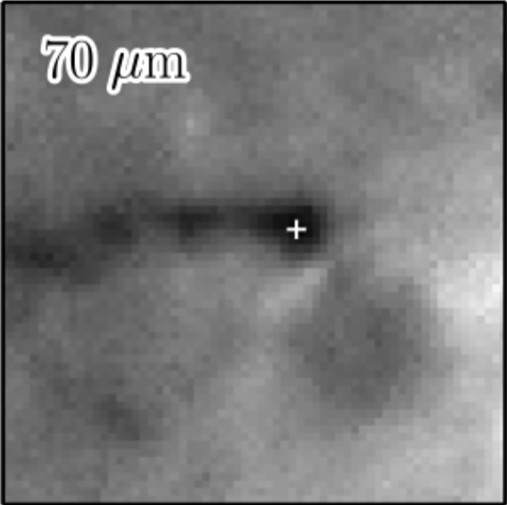
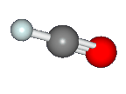
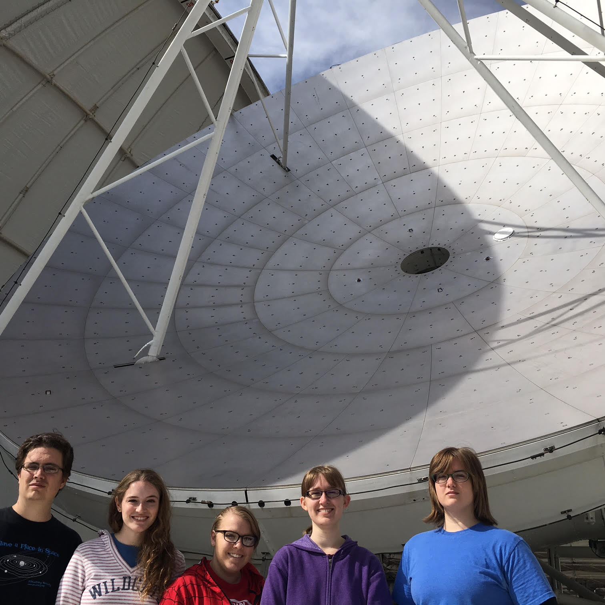
101 Objects observed using the HCO+ J 1-0 transition
J 1-0 transition traces densities of ~10³ /cm³
~60 mins of integration per source
~30 mins pointed at the source
~30 mins pointed at an OFF position
Notes:
Critical density
----- Meeting Notes (5/4/16 17:24) -----
UV background, dominate heating source

Slide 7
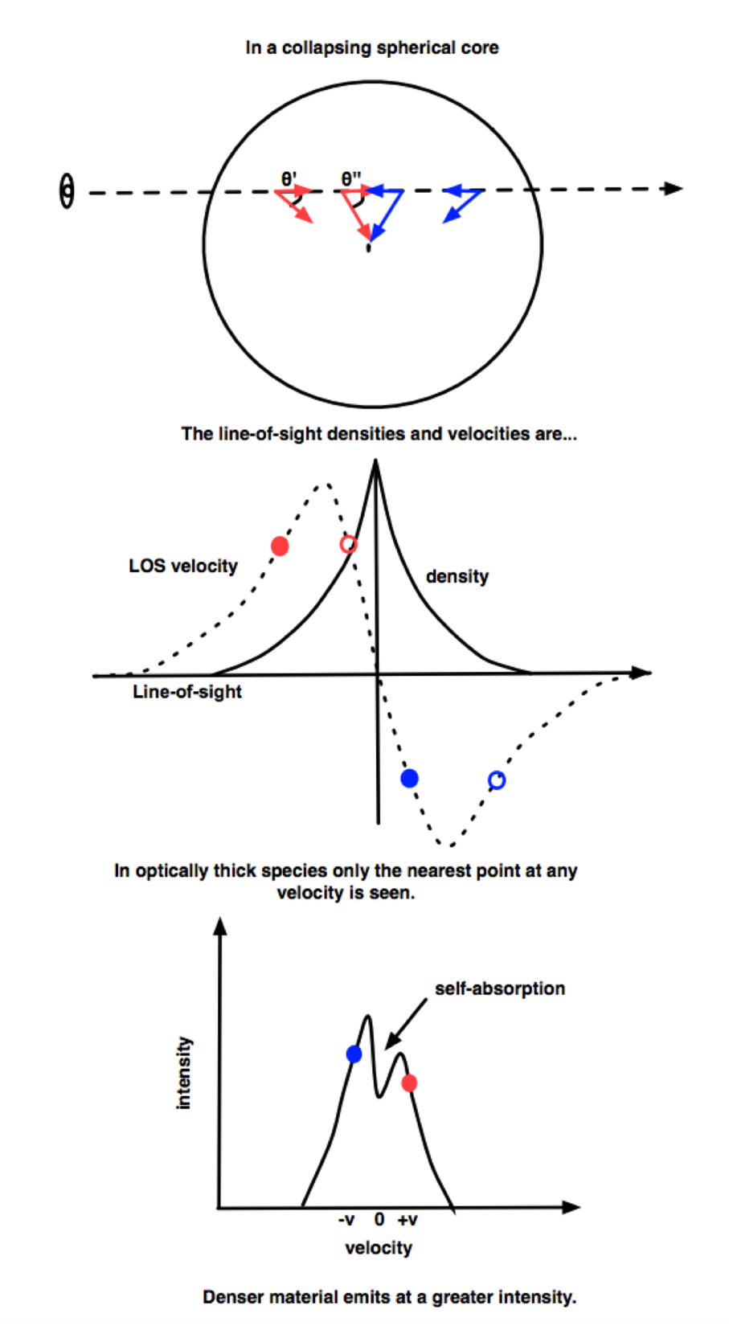
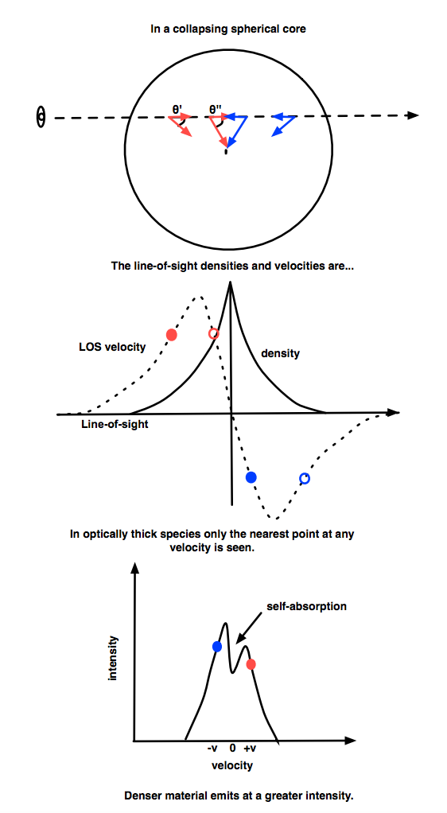
Theory behind blue asymmetry profile
C
H
H
C
Smith Et. Al. (2012)
Notes:
Assumptions: r increasing towards center
temp increasing towards center
optically thick
T exitation temp sensitive to density and density is going up
----- Meeting Notes (5/4/16 17:24) -----
Explain the picture

Slide 8


Theory behind blue asymmetry profile
C
H
H
C
Smith Et. Al. (2012)
Notes:
Assumptions: r increasing towards center
temp increasing towards center
optically thick
T exitation temp sensitive to density and density is going up
----- Meeting Notes (5/4/16 17:24) -----
Explain the picture

Slide 9
Theory behind blue asymmetry profile
Smith Et. Al. (2012)

Slide 10
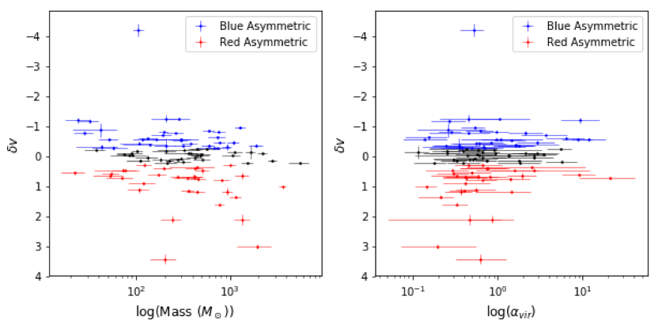
Representing Asymmetry Numerically
δv
positive: red asymmetry negative: blue asymmetry
near zero: Gaussian
Notes:
----- Meeting Notes (5/4/16 17:24) -----
Equation not needed?
Why we use ammonia

Slide 11
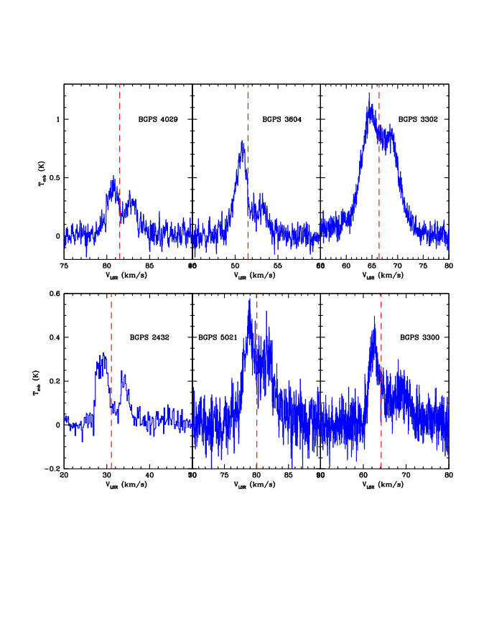
Best inflow candidates
Notes:
Replace me!!!!
These are awesome.
Make bigger (integrated for 2 hrs per source on 103 sources. How many hours?)
Go U of A

Slide 12
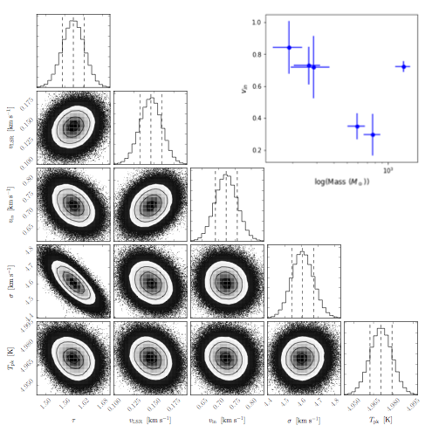
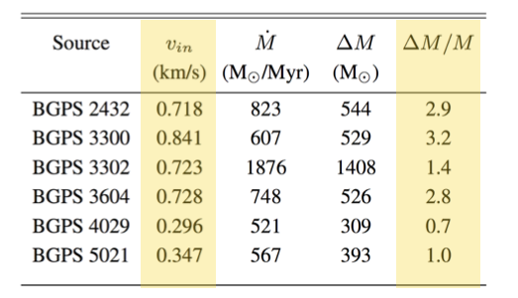
Best Candidates Follow-up
Significantly high infall velocities, most objects will at least double in mass over their lifetime as a starless clump.
Currently following up with ALMA and GBT,
see Svoboda, Shirley et. al 2018

Slide 13
Results
Only 6% of our cores show a strong infall signature → pretty rare
Does not seem to be a relationship between clump parameters and likelihood of infall
Paper accepted by Astrophysical Journal: Calahan et al. 2018 ☺
Notes:
special b/c these clumps were selected from a blind survey- very good sample
representative of whole galaxy
6% either efficiency of forming stars is low OR all of them undergo formation, and infall stage is very quick
nondetections have useful info too

Slide 14
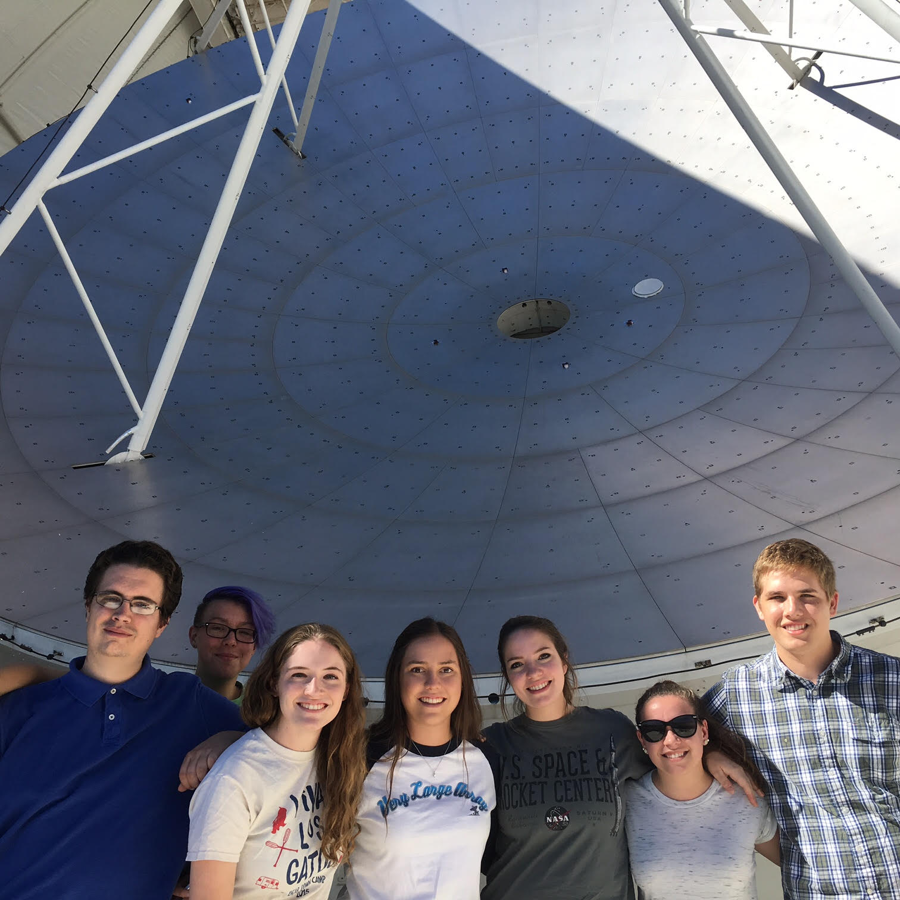
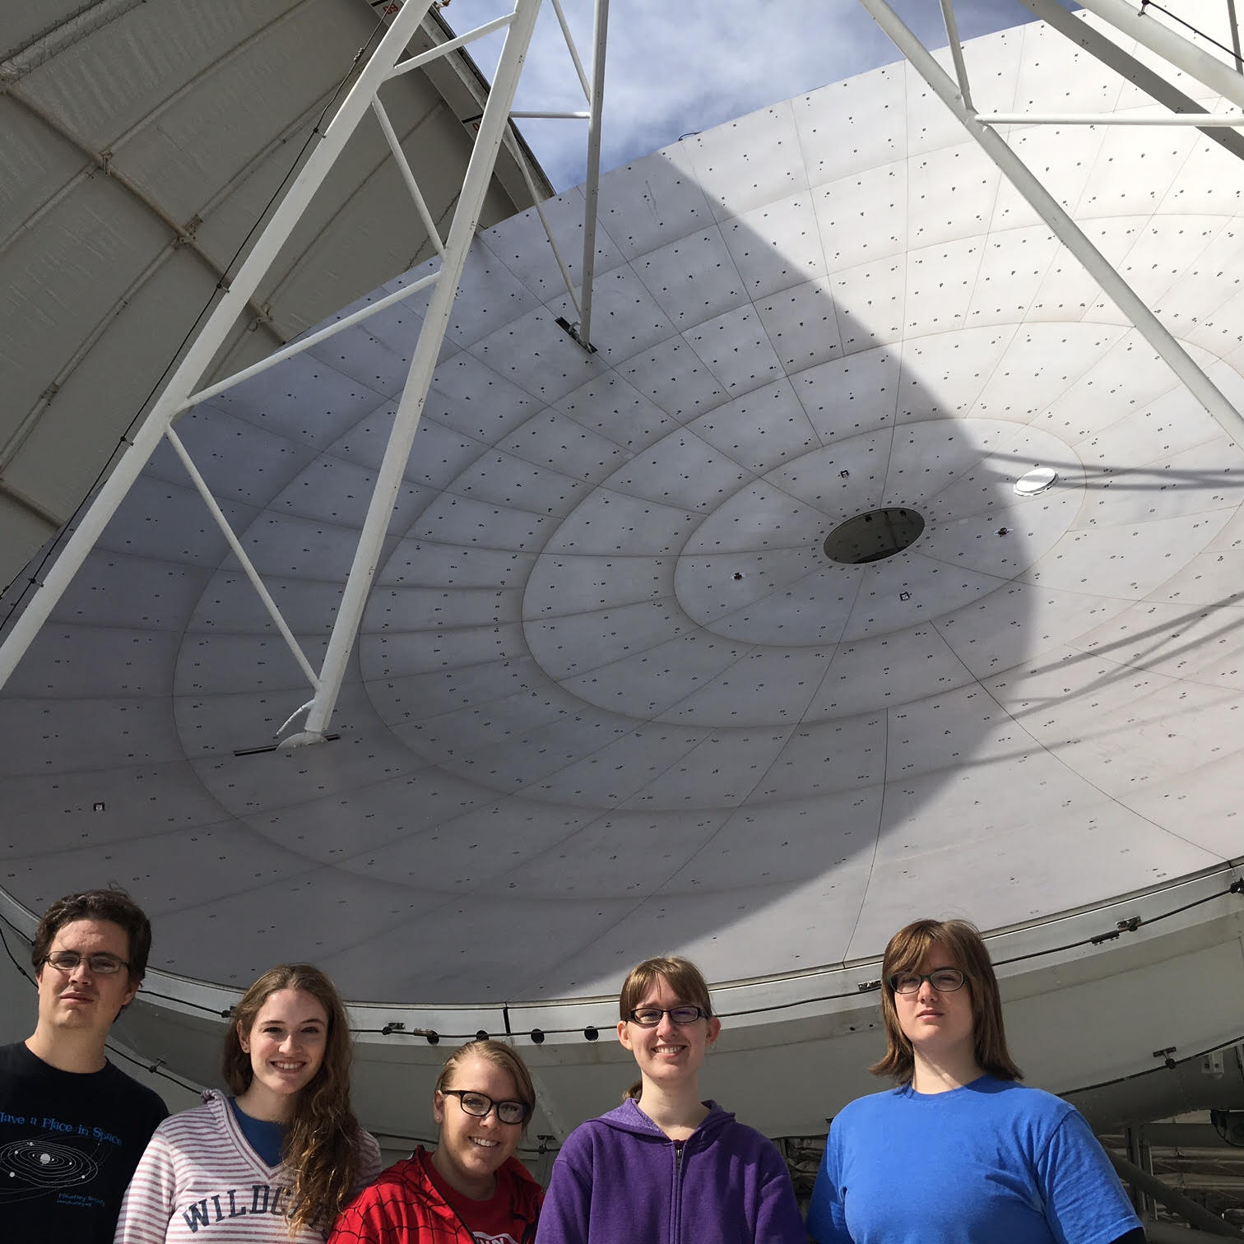
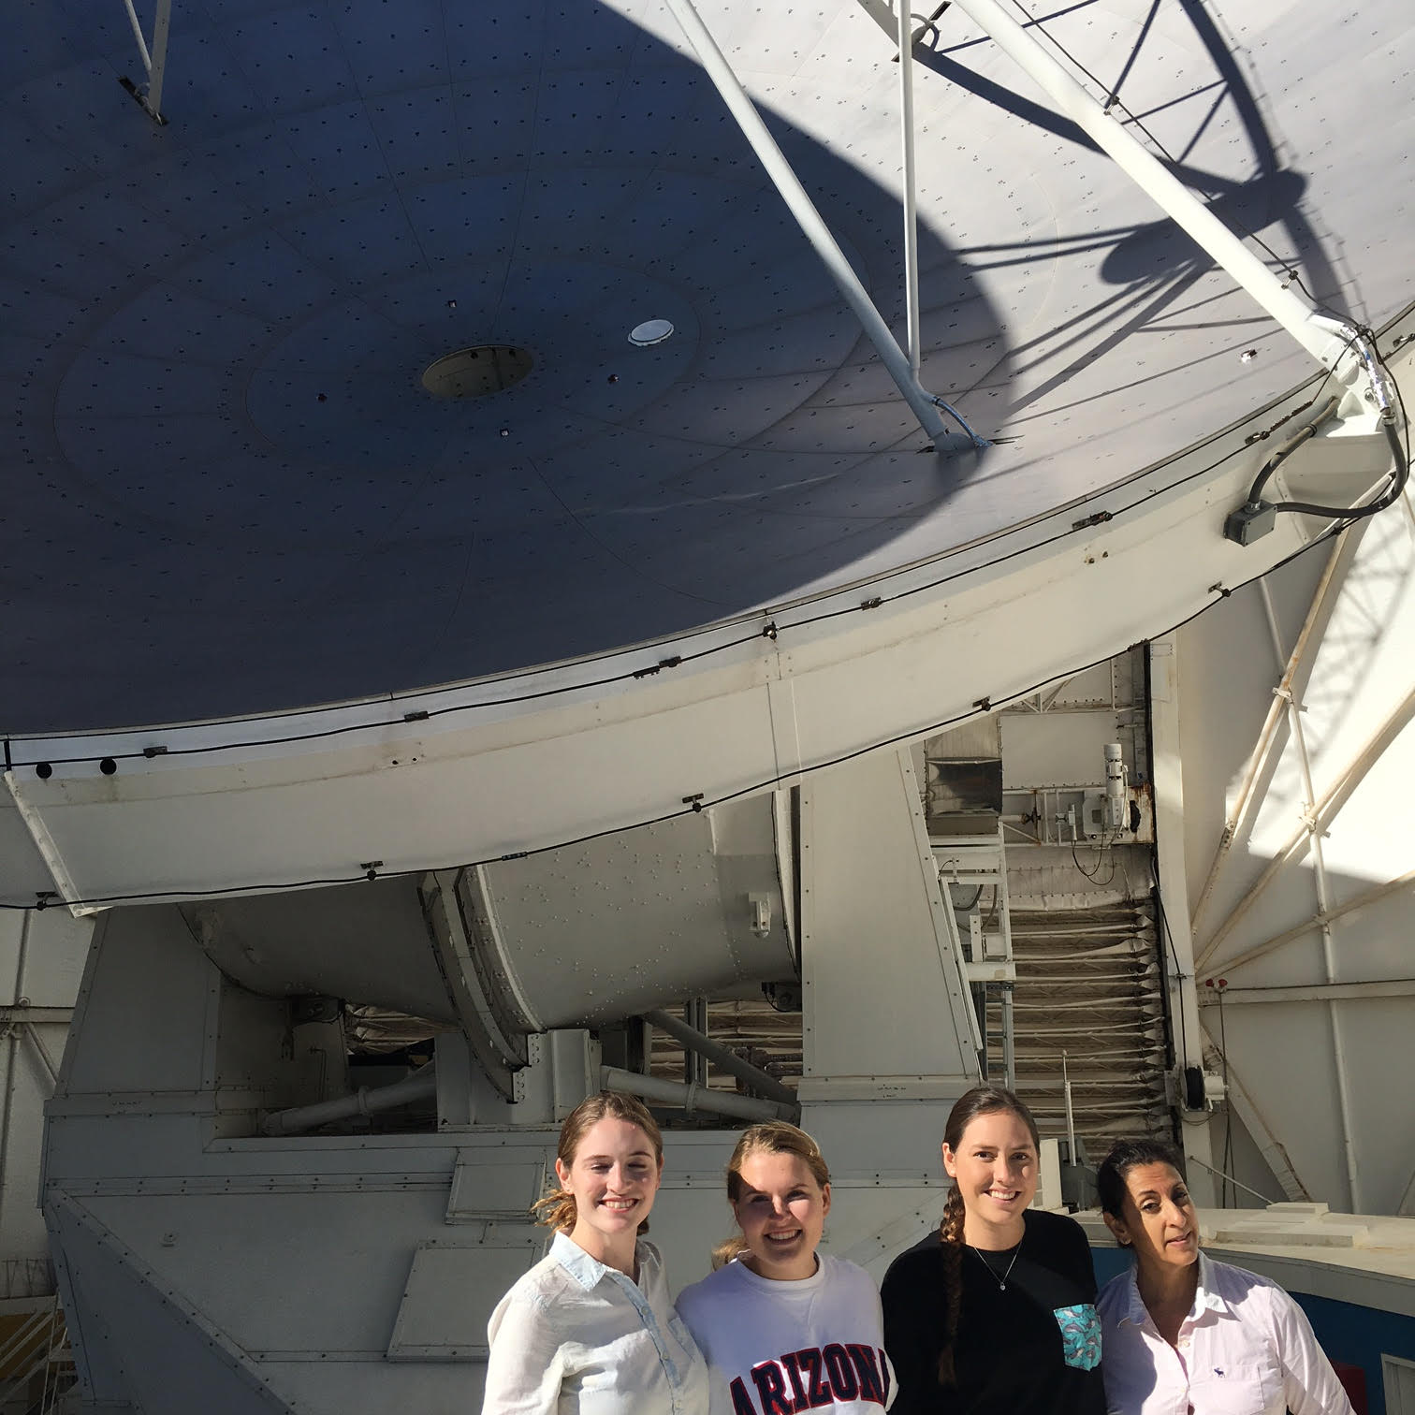
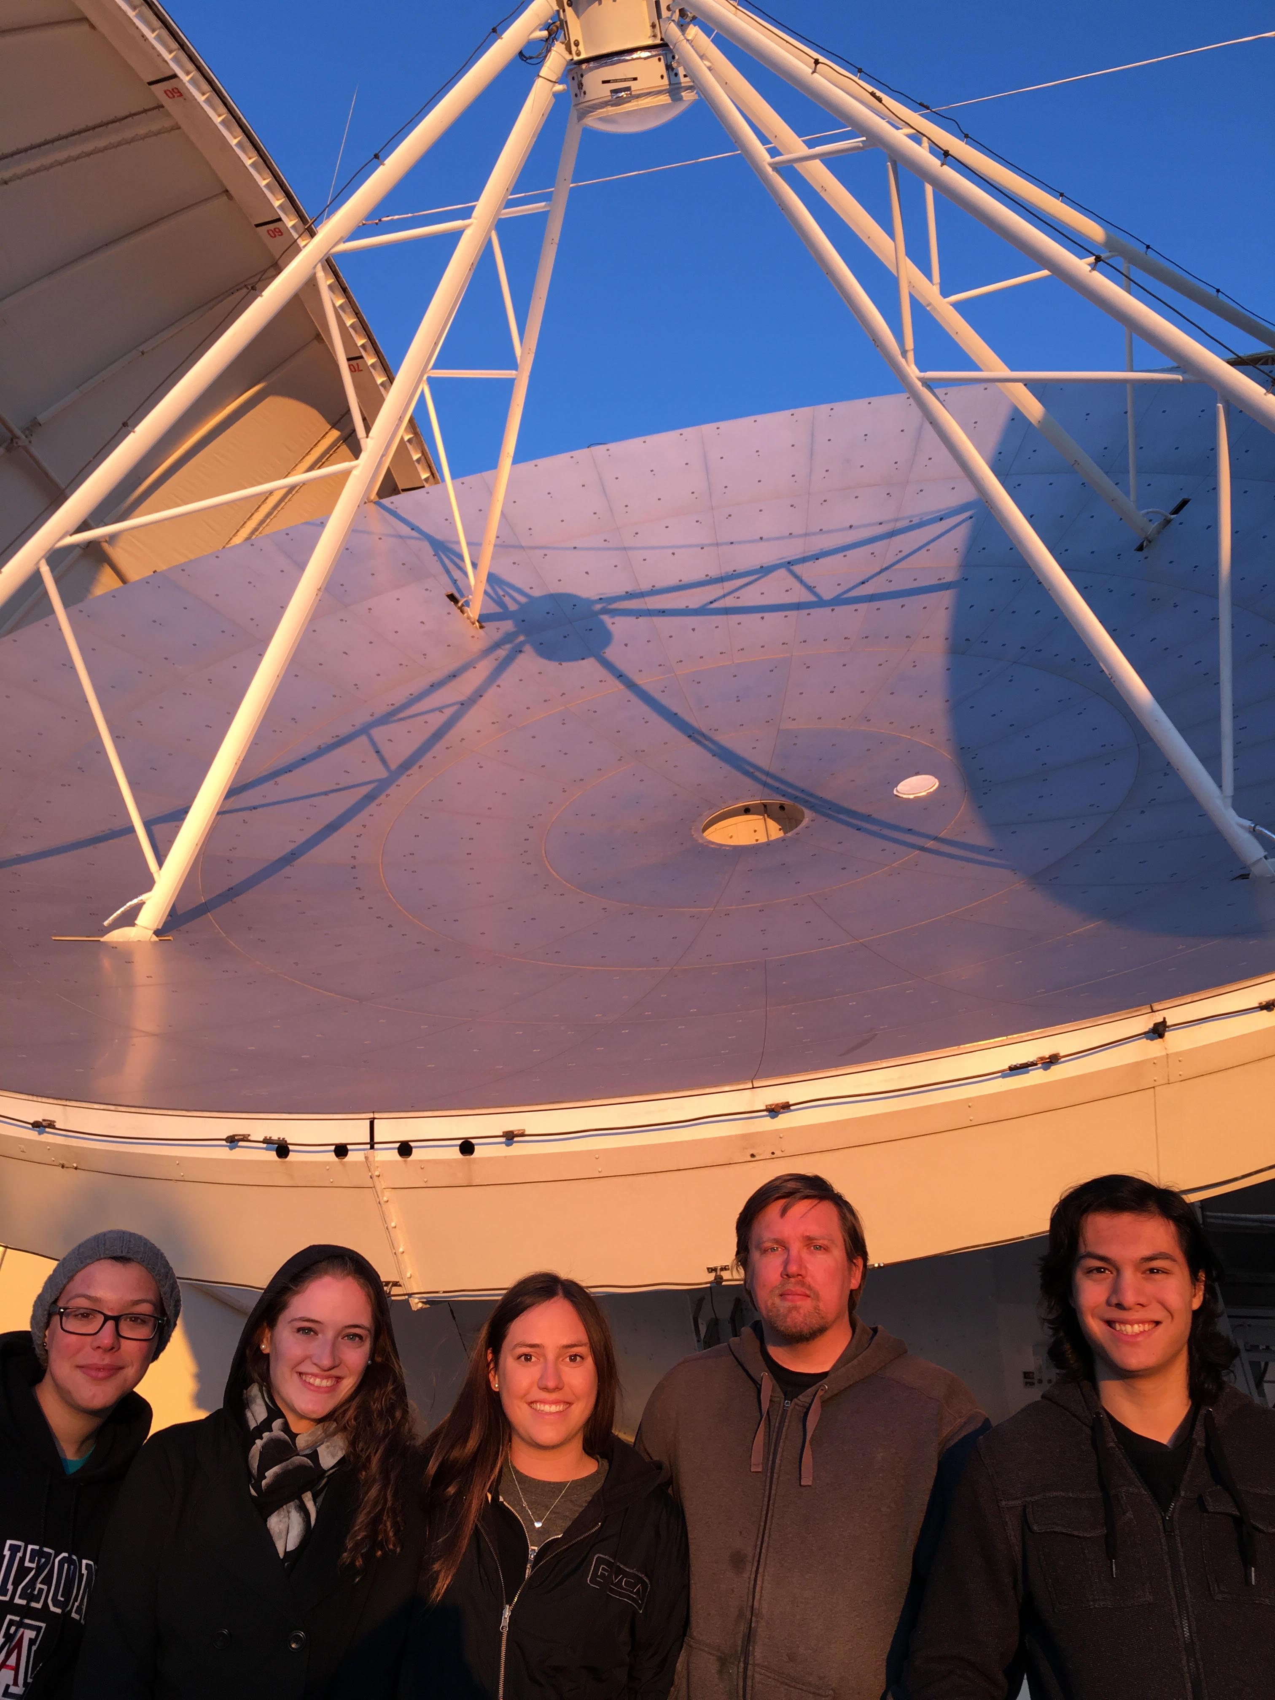
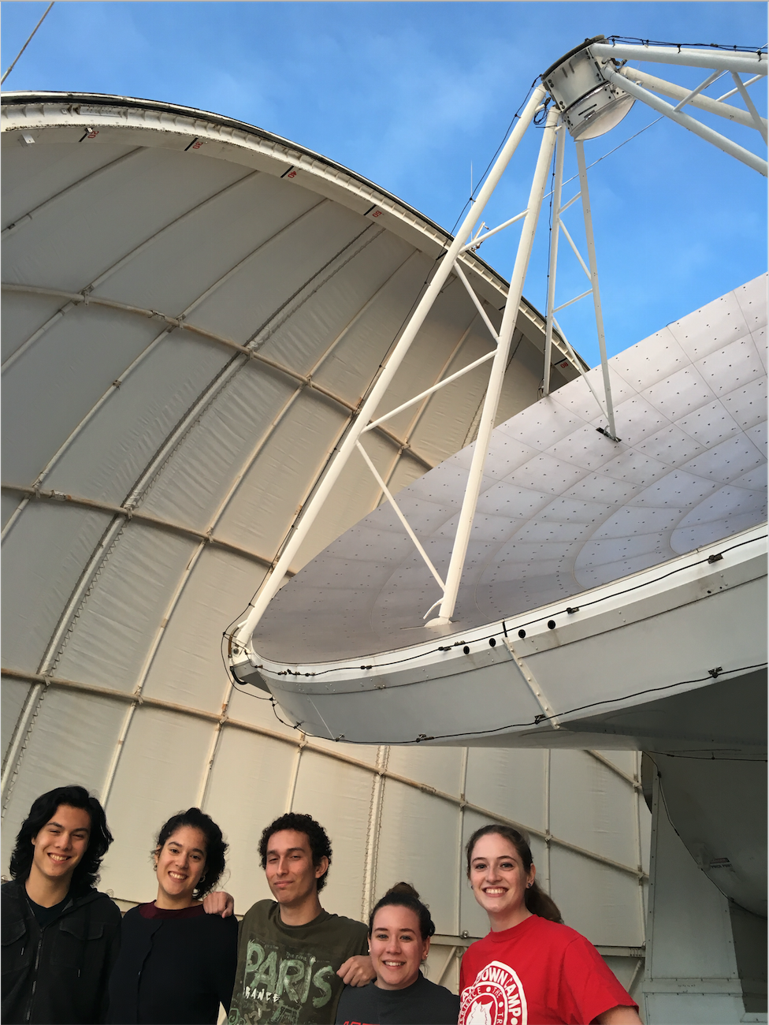
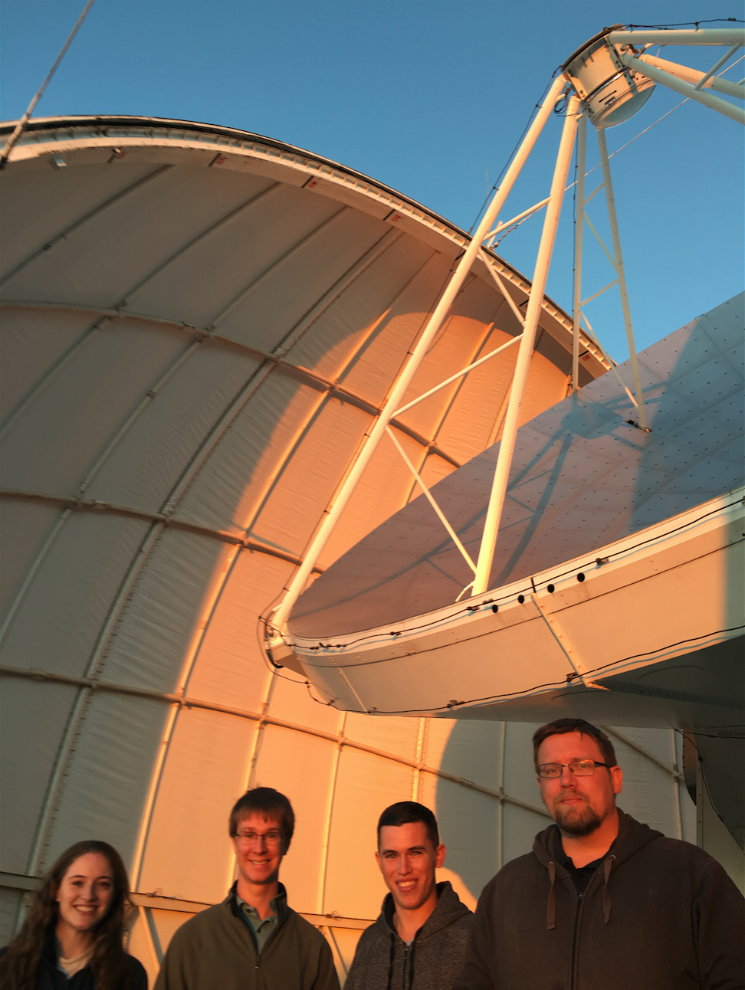
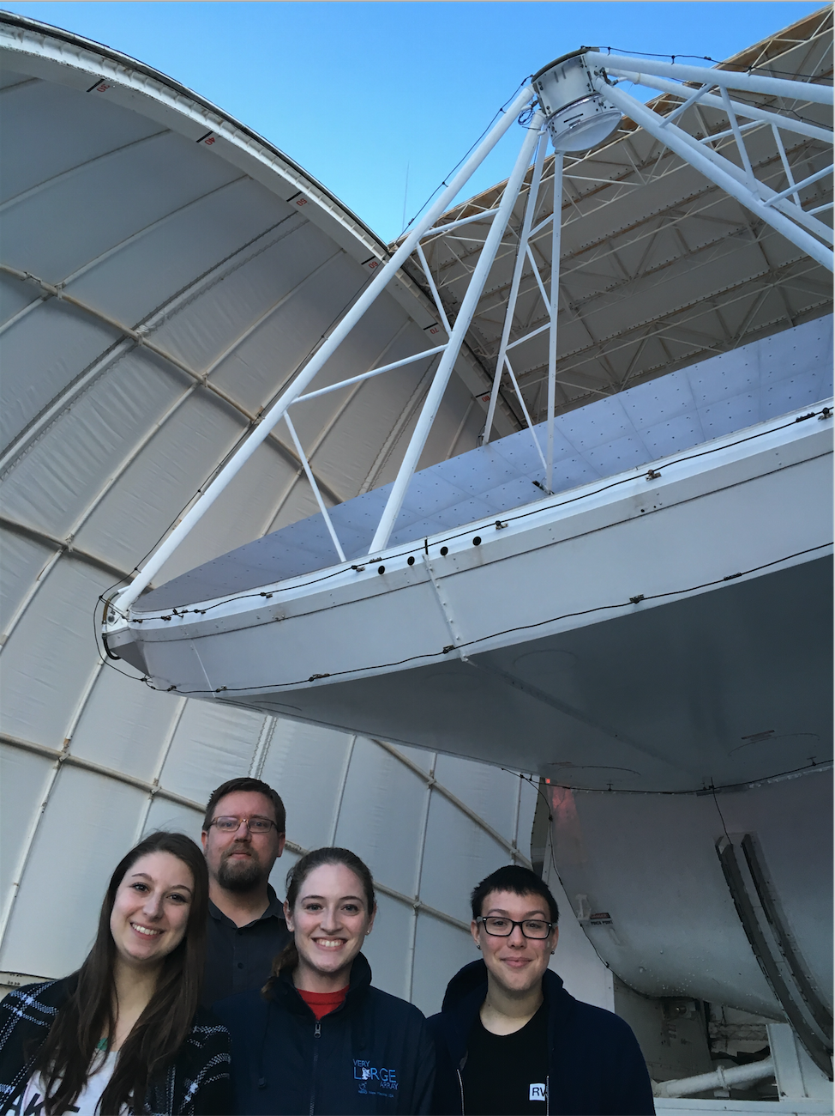
Thanks to Astronomy Club!

Slide 15
Special thanks to:
NASA Space Grant
Brian Svoboda
Graduate Student, Steward Observatory
Dr. Yancy Shirley
Research Advisor and Astronomy club Faculty Advisor

